Slide 1
R Clinic
Session 16
Exporting documents and writing reports in R
Please take a seat at computers 12-19, 26-41 or 48-55.
These have the most up to date version of R installed
Thank you

Slide 2
Outputs
for publication
for reports
for getting others to quickly and easily understand what you're talking about…

Slide 3

Outputting data and summaries
write.csv(object, file pathway, ….)
write.table(object, file pathway, ….)
some models can have HUGE outputs... cat()

Slide 4
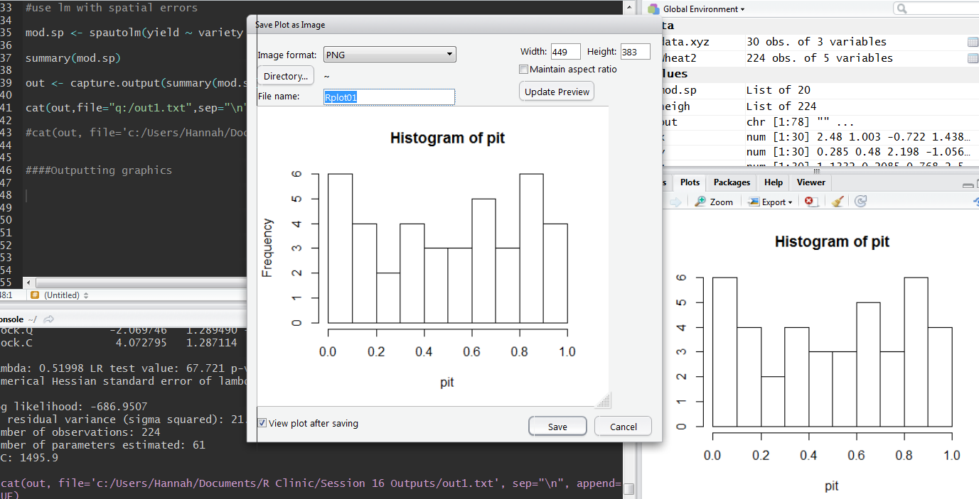
Outputting graphics

Slide 5
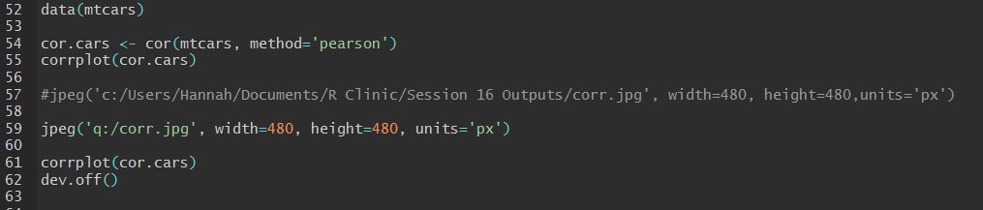
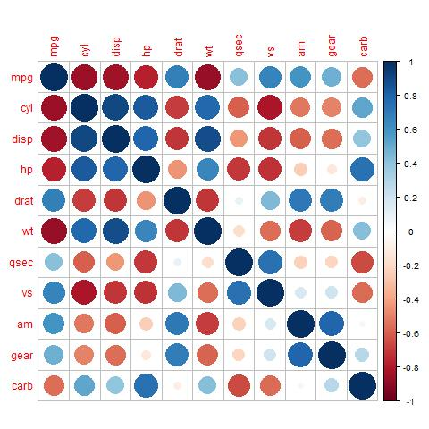

Slide 6
What is R Markdown?
Allows ‘easy creation of dynamic documents, presentations and reports in R’.
Creates many different doc formats, inc:
Word
HTML
PDF
Slidy presentations
Shiny web apps
Combine R code, R outputs and annotative text.

Slide 7
Why use R Markdown?
Reproducible research
Easy communication with supervisors/collaborators
Great for blog posts and quick communications
Looks great for little effort
Easy reformatting

Slide 8
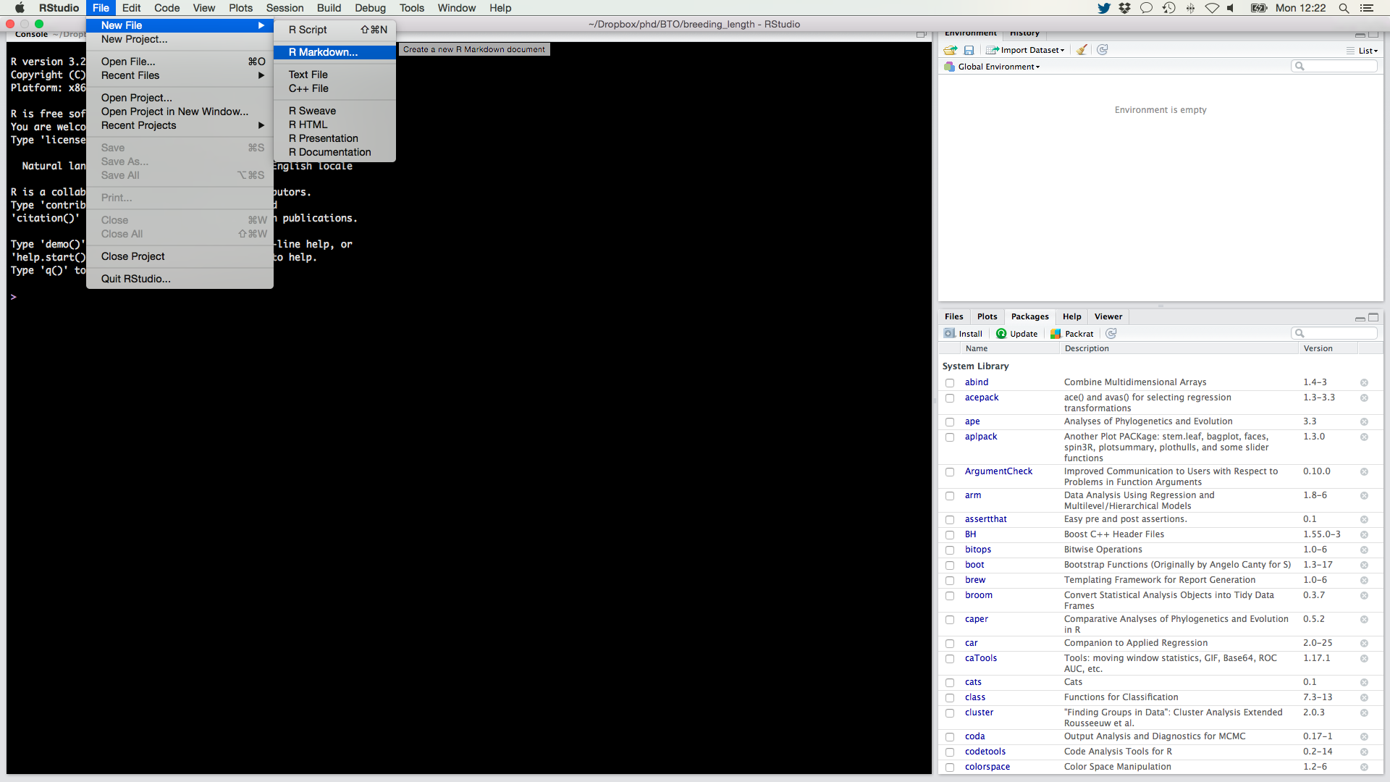
Opening a new Markdown doc
File > New File > R Markdown…

Slide 9
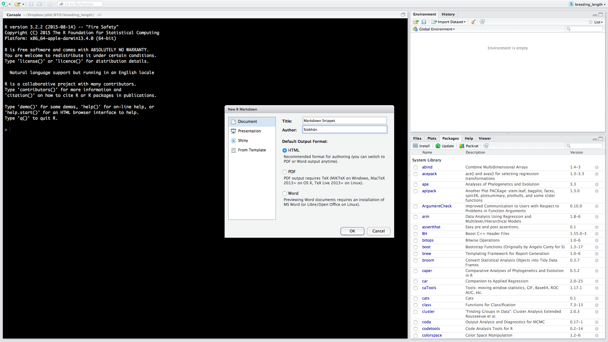
Select document type and output format
In this example we will create a HTML Document

Slide 10
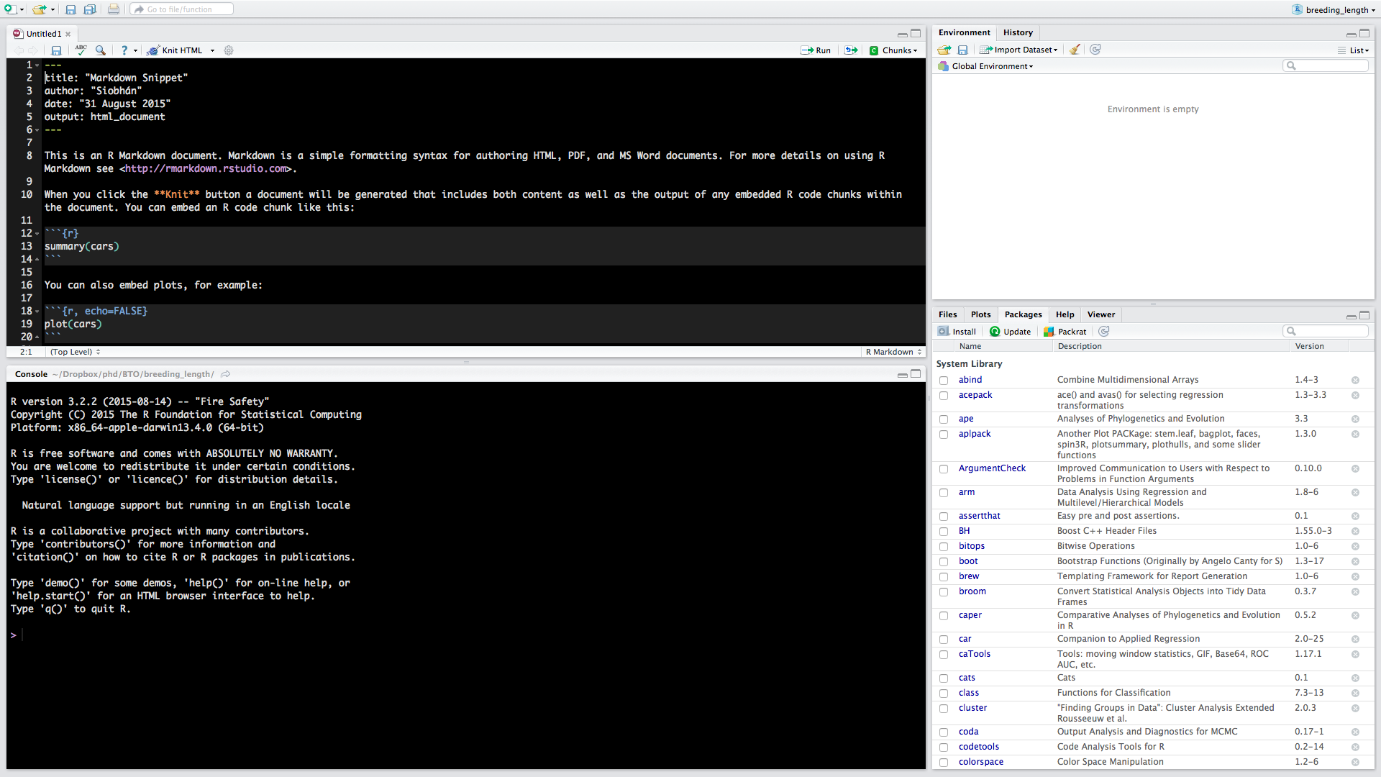
Your new script will have examples of using Markdown
Click “Knit HTML” to test these out

Slide 11

Getting started…
So many online guides and repositories
Cheat sheet and reference guide in the Dropbox
Play around
http://hyperboleandahalf.blogspot.co.uk/2010_06_01_archive.html

Slide 12
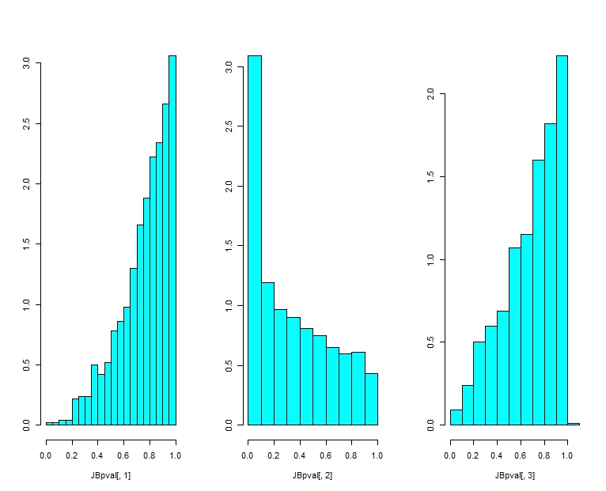
Next week…
GLMs and non-gaussian distributions

